Slide 1
Implementation of SCION on IoT Applications Vishnu Mohan, Baizil MD

Slide 2
Introduction
IoT application over a highly secure network.
Raspberry Pi as the microcontroller unit.
16 x 2 LCD to display the contents/data that are received through SCION.

Slide 3
IoT application chosen
Retail offer management.
Mainly two parts
One server part with load cell which will monitor the weights of the items available for sale.
On the client side, the weight sensor data is written to an LCD display.
Communication between the two parts are conducted through SCION network.

Slide 4
SCION Network
Scalable, Control and Isolation on Next Generation Networks- SCION.
Address the issues on data transmission, scaling and mobility of existing architecture.
Provides transparent operation

Slide 5
Isolation Domain (ISD)
Fundamental building block of SCION network.
Group of ASes.
ISD core consists of multiple
core ASes.
Two type of routing
Intra ISD routing.
Inter ISD routing.

Slide 6
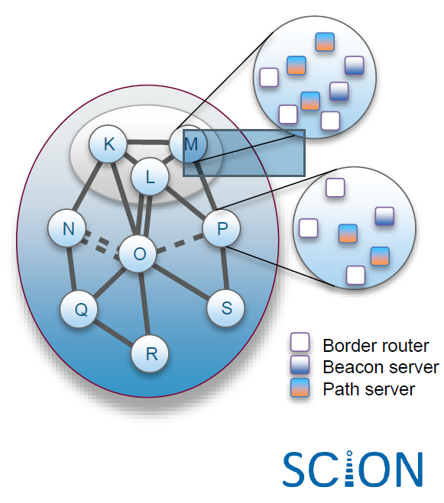
Scion Services
Path Servers- offer lookup service.
Beacon Server- send PCB‘s.
Border Router- receive PCB and select one beacon server to forward.

Slide 7
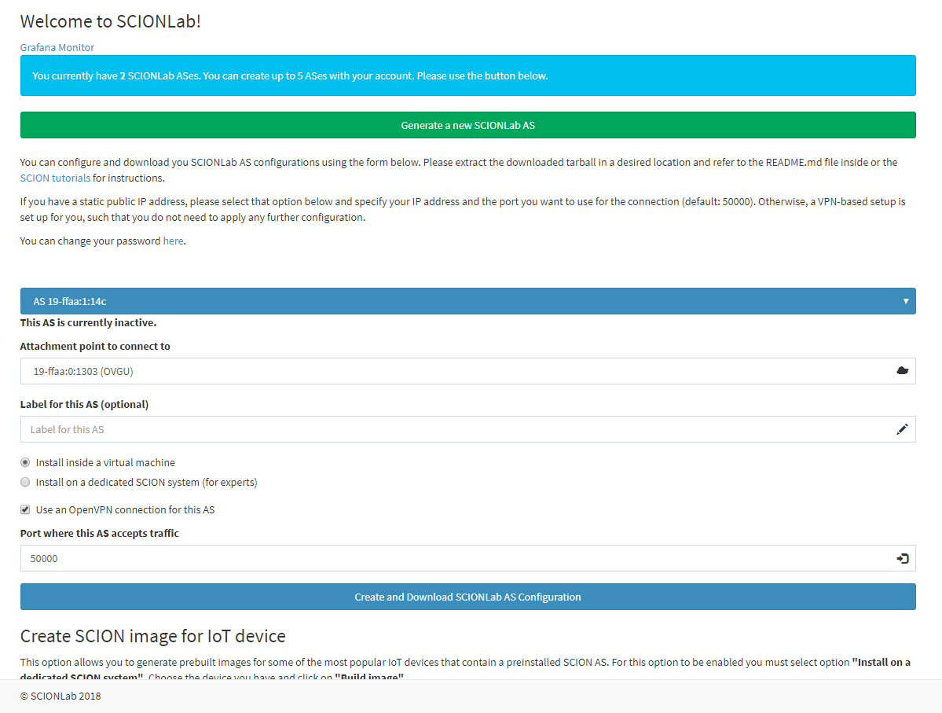
Installation of SCION in Virtual Machine
Log in to www.scionlab.org.
Follow the instructions in SCION Tutorials on how to run SCION in virtual machine with VPN.

Slide 8
Installation of SCION on Raspberry Pi
Download a copy of Raspbian OS and Ubuntu MATE for Raspberry Pi 3B+ .

Slide 9
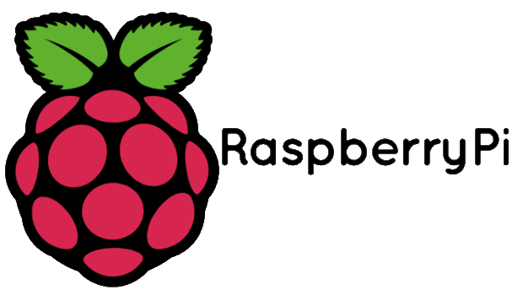
IoT Device
The IoT device we chosen is the Raspberry Pi 3B+.
Has 40 GPIO pins.
Connected with lcd dispaly and act as scion client

Slide 10
16 x 2 LCD Display
Commonly used electronic display module.
Capable of showing two lines of 16 characters each.
Data is transferred through data pins D0 to D7.

Slide 11
LCD Initialization
LCD has mainly two operation modes
Command mode- when register select is low
Data mode- when register select is high
Initialy, the LCD undergoes command mode inorder to clear the screen and assign cursor position etc.
For writing data we should make RS (register select)=1 and
R/W (read or write)=0

Slide 12
Hardware Connection between Raspberry Pi and LCD

Slide 13
Client-Server Communication
The Raspberry pi with load cell act as SCION server and Raspberry Pi with LCD display act as SCION client.
The server AS in the load cell side will fetch the data from palette.
The server AS in the VM will receive that data and will send the same to the client Raspberry Pi side.
Raspberry Pi will pass the data in to the LCD display.

Slide 14
Flow of Data

Slide 15
Why SCION ?
Secure against various attackes.
High assurance of communications (if adversary-free path exists).
Path control availability to client and server.
Scalability
Efficiency

Slide 16
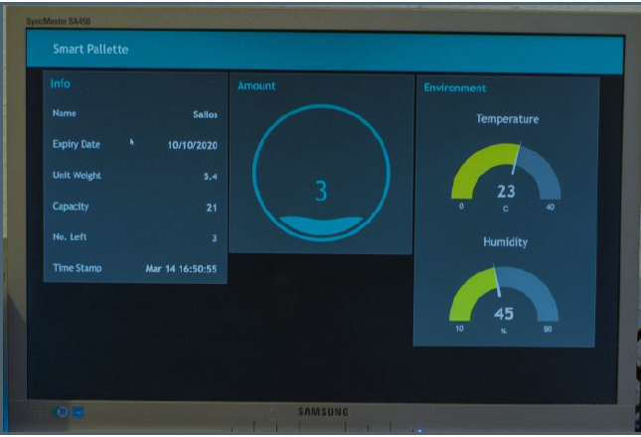
GUI Implementation
Contents viewable at the LCD has been visualized on the virtual machine.
Uses development tool NODE-Red.
Browser-based flow editing.

Slide 17
Testing
For testing we used the local virtual machine as server.
The server will always look for any client request.
Once server-client connection is established the server will pass the testing data that we have written in code(“Testing 123” ).

Slide 18
Results
Once a connection is established between server side(Raspberry Pi with load cell) and client side ( Raspberry Pi with LCD display, the data from the pallette will be showed in LCD.
The LCD will display the product name, weight, count of the items in the pallete, and temperature.

Slide 19
Difficulties Faced during this Project
The main hurdle we faced is during the installation of SCION on Raspberry Pi 3B+ , as this is the newest raspbeery edition the the SCION image was not readly available.
Familiarizing with Go language and writing code in Go.

Slide 20
Further Works
Auto announcement of discounts after the weight of a product drops to last few kilograms of the stock.
By adding temperature sensors to the module, which can be used to monitor the temperature of a cold storage.

Slide 21
References
“SCION: A Secure Internet Architecture”, ETH Zurich, Aug 2017. [Online]Available: https://www.scion-architecture.net/pdf/SCION-book.pdf.
SCION tutorials, Welcome to SCION Tutorials. Available: https://netsec-ehz.github.io/scion-tutorials/.
URL:https://www.raspberrypi.org/products/raspberry-pi-3-model-b-plus/.
Node-Red, Flow-based programming for Internet of things. Available: https://nodered.org/.
Go, The Go Programming Language. Available: https://golang.org/.

Slide 22
Thanks for your attention....

